Slide 1
CANADIAN CHECKERS
CSE 4110 – Artificial Intelligence Laboratory
1707040 – Rahat Mahmud Khan
1707057 – Talha Ibne Mahmud
1707060 – Rakibul Haque

Slide 2
An overview
Canadian checkers (or Canadian draughts) is a variant of the strategy board game “draughts” or “checkers”.
It is one of the largest draughts games, played on a 12×12 checkered board with 30 game pieces per player.
The game was invented by the French settlers of Quebec, Canada; it was named Grand jeu de dames.

Slide 3
Game description
Canadian checkers are played on a 12x12 board of alternating dark and light colours
The board is placed so that both players have the dark square on their left edge of the first row
Each player has 30 pieces to start with
The pieces are usually coloured in RED and WHITE
The pieces are placed on the dark squares of the first 5 rows of each side
The player with the lighter-coloured piece moves first. Then turn alternates

Slide 4
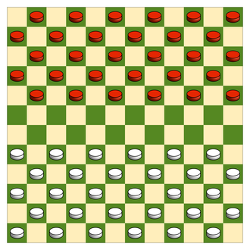
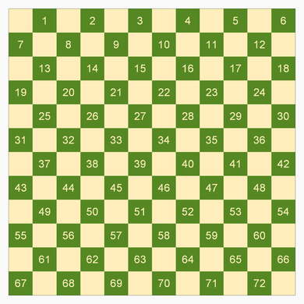
Starting position & Notation

Slide 5
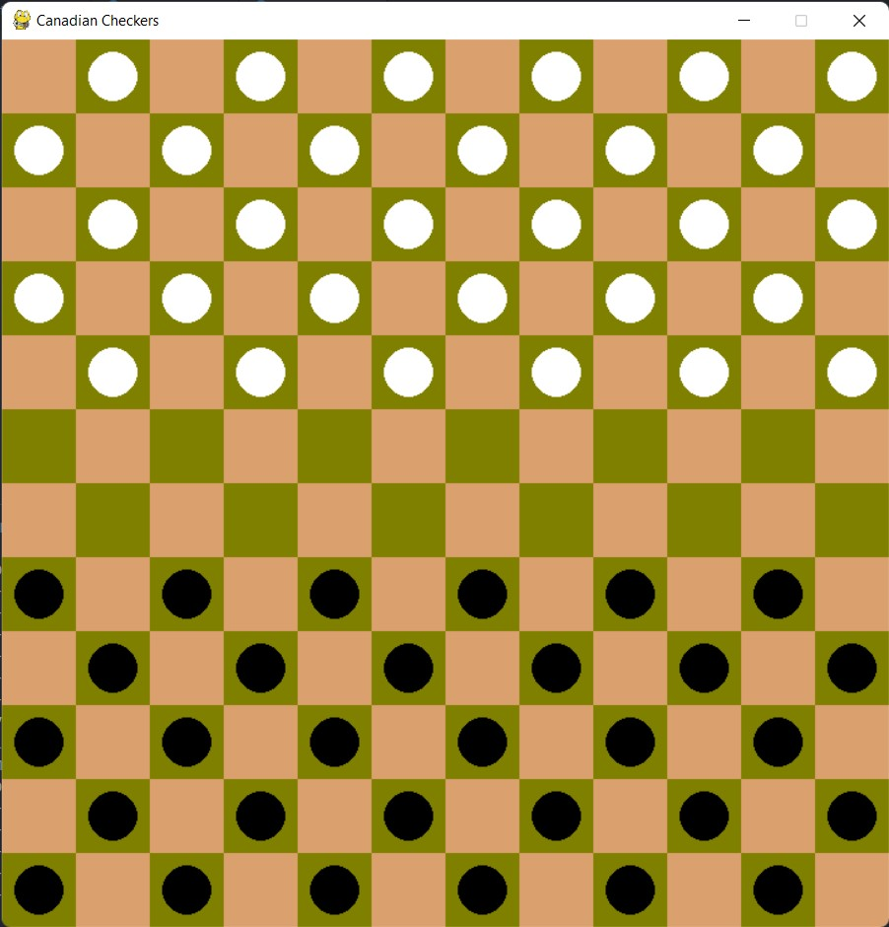
Game rules
Moves
The general rule is that all moves and captures are made diagonally
The player with the light pieces moves first. Then turns alternate.
Ordinary pieces move one square diagonally forward to an unoccupied square.

Slide 6
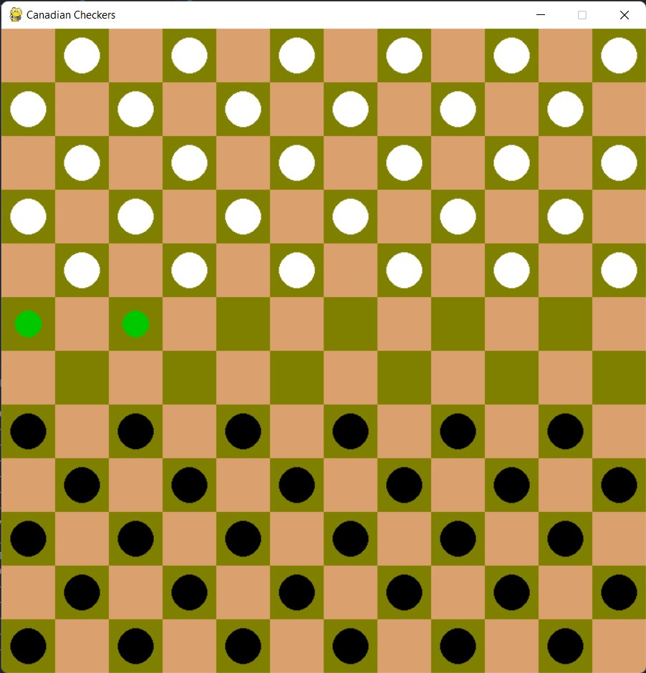
Game rules
Moves
The general rule is that all moves and captures are made diagonally
The player with the light pieces moves first. Then turns alternate.
Ordinary pieces move one square diagonally forward to an unoccupied square.

Slide 7
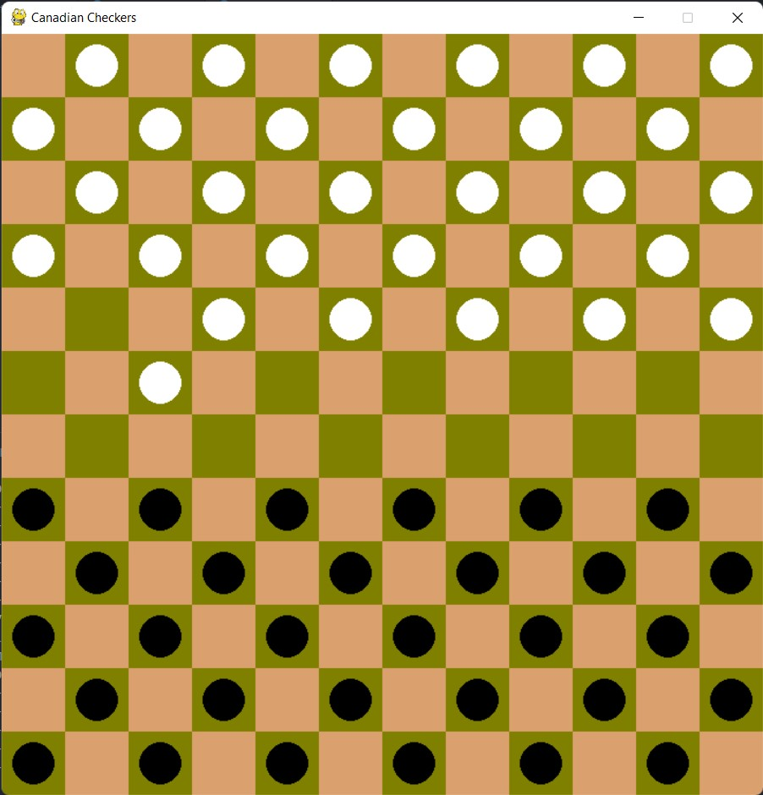
Game rules
Moves
The general rule is that all moves and captures are made diagonally
The player with the light pieces moves first. Then turns alternate.
Ordinary pieces move one square diagonally forward to an unoccupied square.

Slide 8
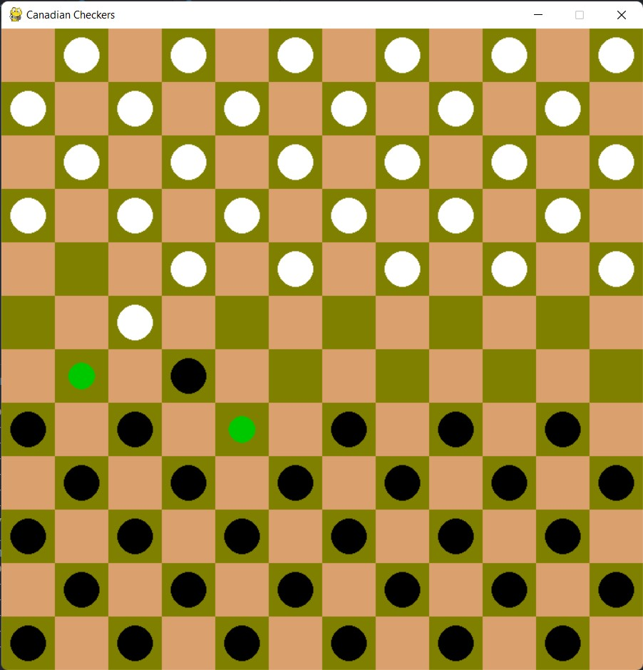
Game rules
captures
Enemy pieces can and must be captured by jumping over the enemy piece, two squares forward or backward to an unoccupied square immediately beyond. If a jump is possible, it must be done, even if doing so incurs a disadvantage.
A jumped piece is removed from the board at the end of the turn.

Slide 9
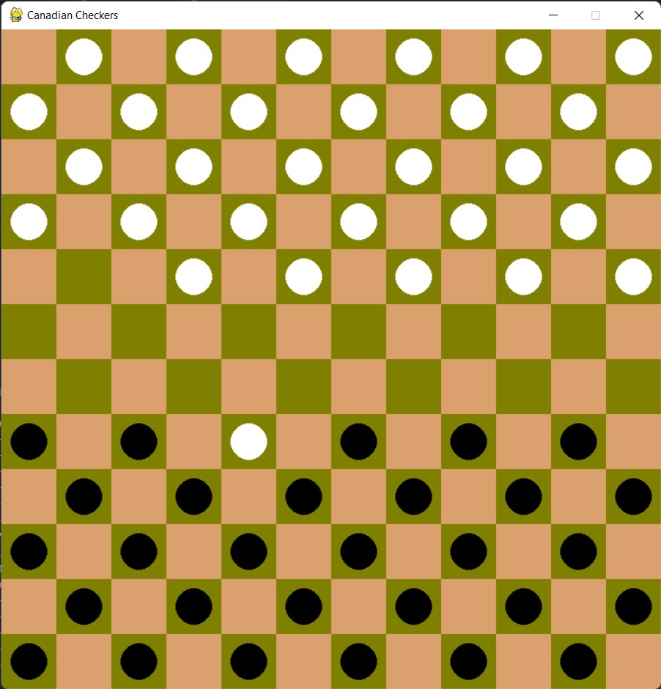
Game rules
captures
Enemy pieces can and must be captured by jumping over the enemy piece, two squares forward or backward to an unoccupied square immediately beyond. If a jump is possible, it must be done, even if doing so incurs a disadvantage.
A jumped piece is removed from the board at the end of the turn.

Slide 10
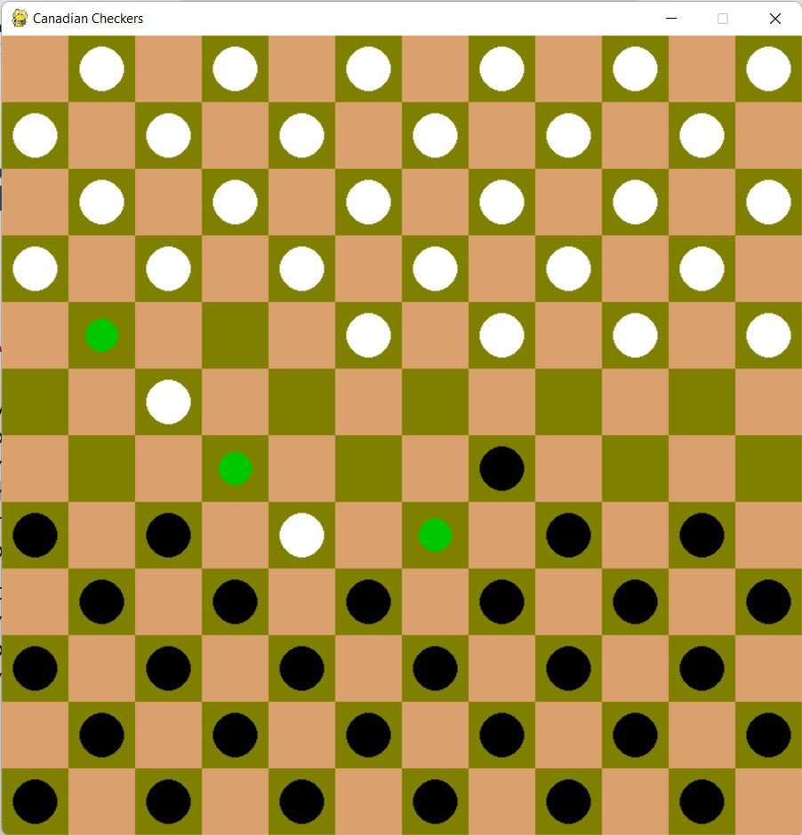
Game rules
captures
Multiple successive jumps forward or backward in a single turn can and must be made if after each jump there is an unoccupied square immediately beyond the enemy piece.
It is compulsory to jump over as many pieces as possible. One must play with the piece that can make the maximum number of captures.

Slide 11
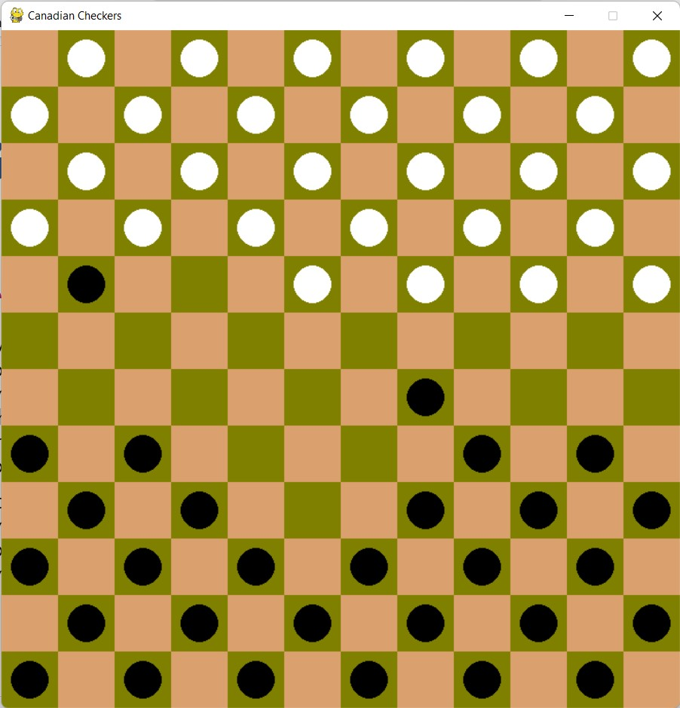
Game rules
captures
Multiple successive jumps forward or backward in a single turn can and must be made if after each jump there is an unoccupied square immediately beyond the enemy piece.
It is compulsory to jump over as many pieces as possible. One must play with the piece that can make the maximum number of captures.

Slide 12
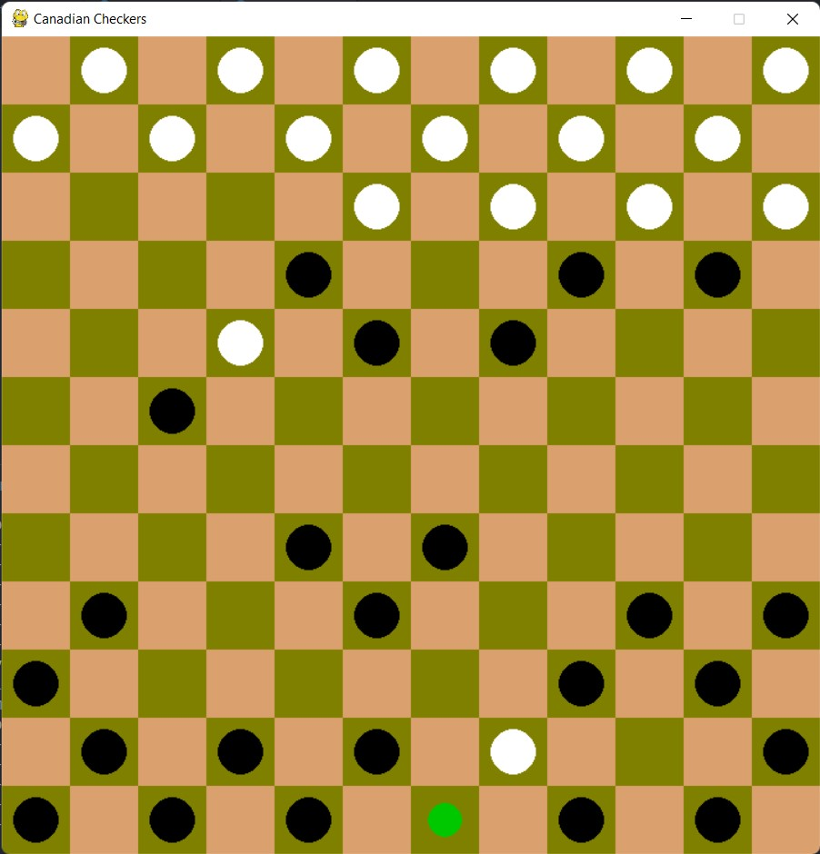
Game rules
crowning
A piece is crowned if it stops on the far edge of the board at the end of its turn.
Crowned pieces, sometimes called kings, can move freely multiple steps in any direction and may jump over and hence capture an opponent piece some distance away and choose where to stop afterwards, but must still capture the maximum number of pieces possible.

Slide 13
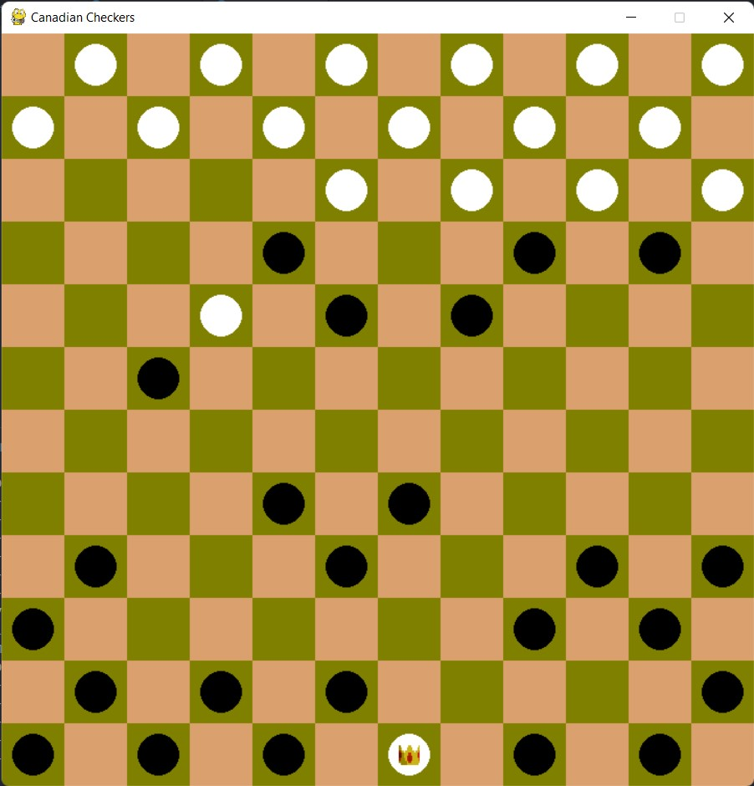
Game rules
crowning
A piece is crowned if it stops on the far edge of the board at the end of its turn.
Crowned pieces, sometimes called kings, can move freely multiple steps in any direction and may jump over and hence capture an opponent piece some distance away and choose where to stop afterwards, but must still capture the maximum number of pieces possible.

Slide 14
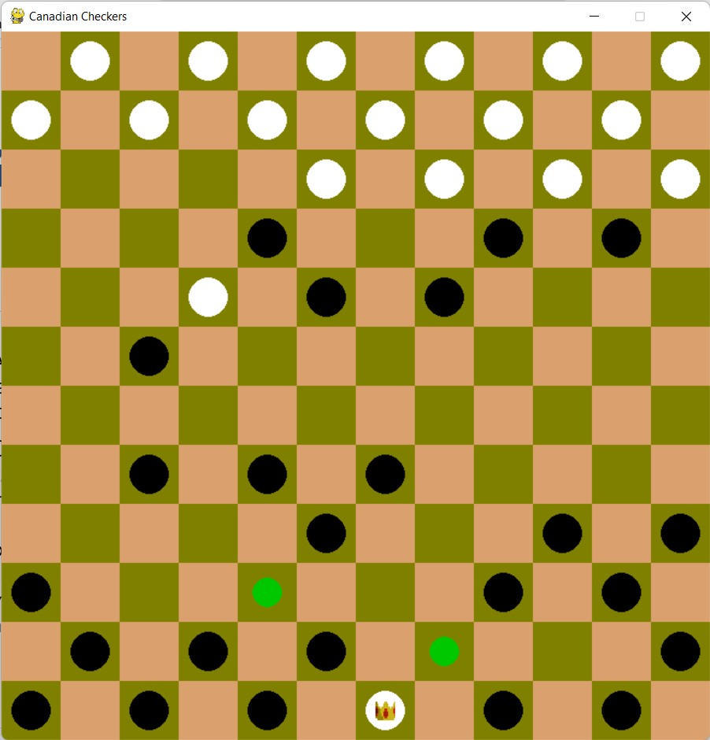
Game rules
crowning
A piece is crowned if it stops on the far edge of the board at the end of its turn.
Crowned pieces, sometimes called kings, can move freely multiple steps in any direction and may jump over and hence capture an opponent piece some distance away and choose where to stop afterwards, but must still capture the maximum number of pieces possible.

Slide 15
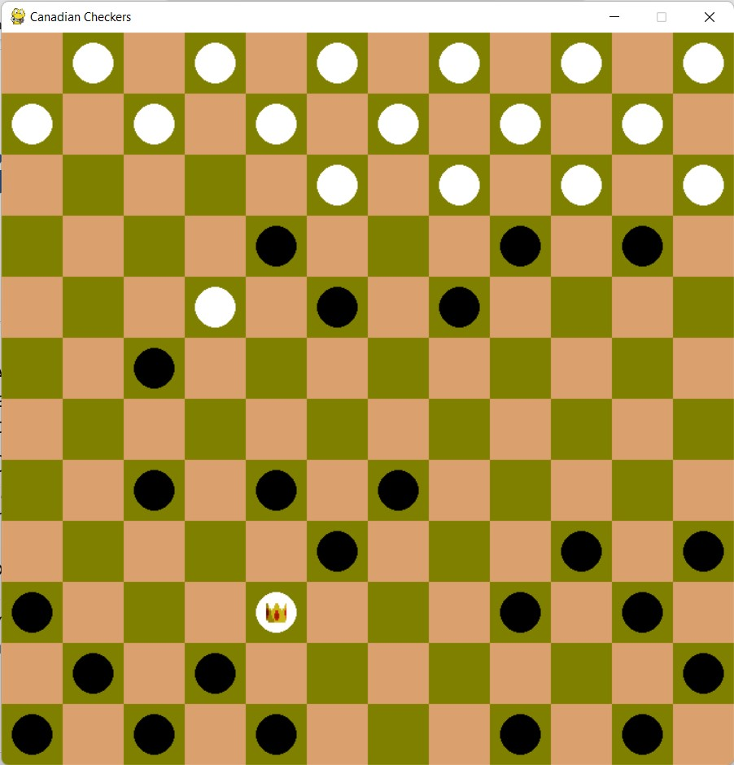
Game rules
crowning
A piece is crowned if it stops on the far edge of the board at the end of its turn.
Crowned pieces, sometimes called kings, can move freely multiple steps in any direction and may jump over and hence capture an opponent piece some distance away and choose where to stop afterwards, but must still capture the maximum number of pieces possible.

Slide 16
Win vs draw
win
draw
A player with no valid move remaining loses. This occurs if the player has no pieces left, or if all the player's pieces are obstructed from moving by opponent pieces.
A game is a draw if neither opponent has the possibility to win the game.
The game is considered a draw when the same position repeats itself for the third time (not necessarily consecutive), with the same player having the move each time.
A king-versus-king endgame is automatically declared a draw, as is any other position proven to be a draw.

Slide 17
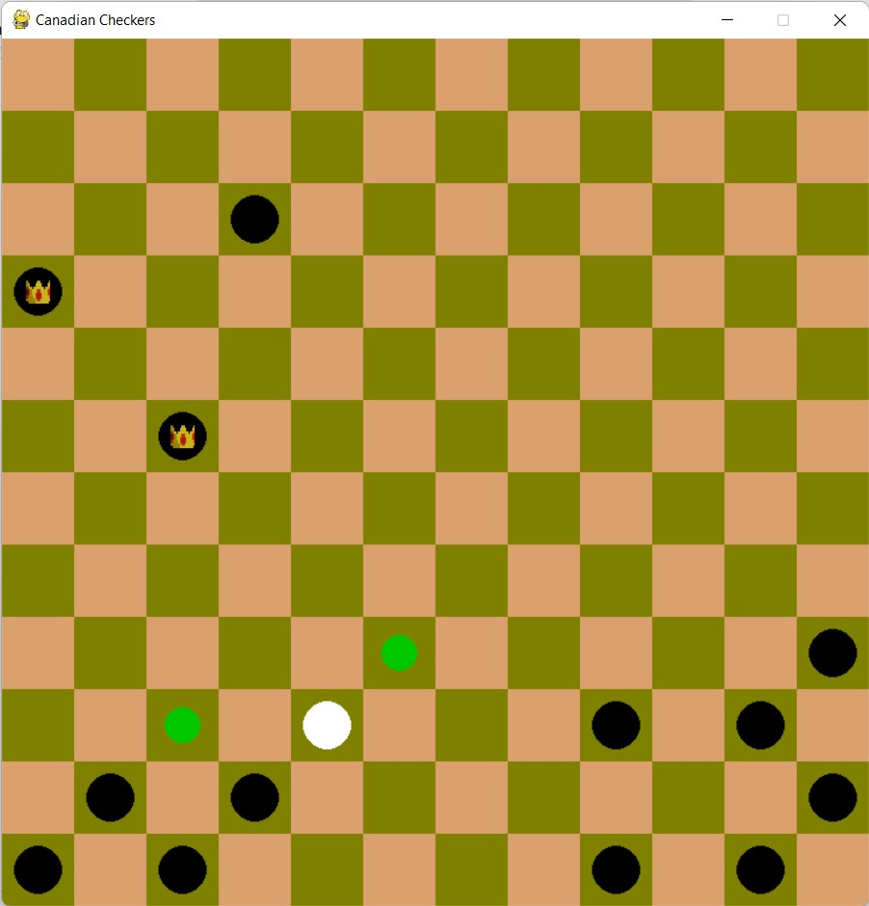
Win vs draw

Slide 18
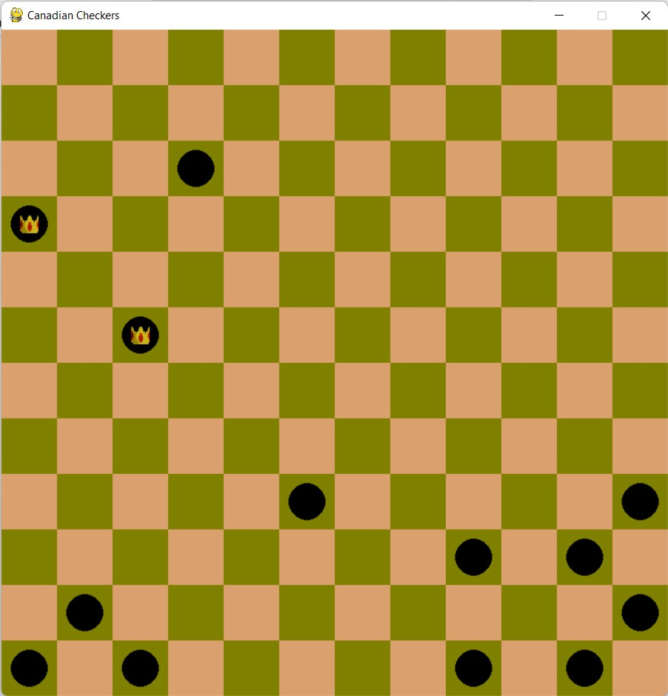
Win vs draw
Black Wins!

Slide 19
Making it work with ai
Points
Point is increased when one captures opposites piece
Objective
The AI wants to win the game by maximizing its point and minimizing human's point
Algorithm
This objective can be achieved with help of Minimax Algorithm and α-β Pruning

Slide 20
Minimax algorithm
Minimax is a kind of backtracking algorithm that is used in decision making and game theory to find the optimal move for a player, if your opponent also plays optimally.
In Minimax the two players are called maximizer and minimizer.
The maximizer tries to get the highest score possible while the minimizer tries to get the lowest score possible.
Every state has a value associated with it. In each state if the maximizer has upper hand, then, the score of the board will tend to be some positive value. If the minimizer has the upper hand in that board state, then it will tend to be some negative value.

Slide 21
Minimax algorithm
MAX
MIN
MAX

Slide 22
Minimax algorithm
MAX
MIN
MAX

Slide 23
Minimax algorithm
MAX
MIN
MAX

Slide 24
Minimax algorithm
MAX
MIN
MAX

Slide 25
Alpha-beta pruning
Alpha-Beta pruning is not actually a new algorithm, rather an optimization technique for minimax algorithm.
It reduces the computation time by a huge factor. This allows us to search much faster and even go into deeper levels in the game tree.
It is called Alpha-Beta pruning because it passes 2 extra parameters in the minimax function, namely alpha and beta.
Alpha is the best value that the maximizer currently can guarantee at that level or above. Beta is the best value that the minimizer currently can guarantee at that level or above.

Slide 26
Alpha-beta pruning
α = -∞
β = ∞
MAX
MIN
MAX

Slide 27
Alpha-beta pruning
α = -∞
β = ∞
MAX
MIN
α = 3
β = ∞
MAX

Slide 28
Alpha-beta pruning
α = -∞
β = ∞
MAX
α = -∞
β = 3
MIN
α = 3
β = ∞
MAX

Slide 29
Alpha-beta pruning
α = -∞
β = ∞
MAX
α = -∞
β = 3
α = 5
β = 3
MIN
α = 3
β = ∞
MAX

Slide 30
Alpha-beta pruning
α = 3
β = ∞
MAX
α = -∞
β = 3
α = 5
β = 3
α = 3
β = ∞
MIN
α = 3
β = ∞
α = 3
β = ∞
MAX

Slide 31
Alpha-beta pruning
α = 3
β = ∞
MAX
α = -∞
β = 3
α = 5
β = 3
α = 3
β = ∞
MIN
α = 3
β = ∞
α = 3
β = ∞
MAX

Slide 32
Alpha-beta pruning
α = 3
β = ∞
MAX
α = -∞
β = 3
α = 5
β = 3
α = 3
β = 2
MIN
α = 3
β = ∞
α = 3
β = ∞
MAX

Slide 33
Alpha-beta pruning
MAX
MIN
MAX

Slide 34
Alpha-beta pruning
MAX
MIN
MAX

Slide 35
Technology used
Platform: Windows/MacOS/Linux
Game Engine: PyGame
Language Used: Python (3.10)

Slide 36
THANK YOU
Rahat Mahmud Khan
Talha Ibne Mahmud
Rakibul Haque

